Slide 1

CSE 350 Digital Electronics and Pulse Techniques
DTL-Noise Margin, Fanout, Power Dissipation
Course Instructor: Shomen Kundu (SDU)
Mail: shomen.kundu@bracu.ac.bd
Desk: 4N148

Slide 2
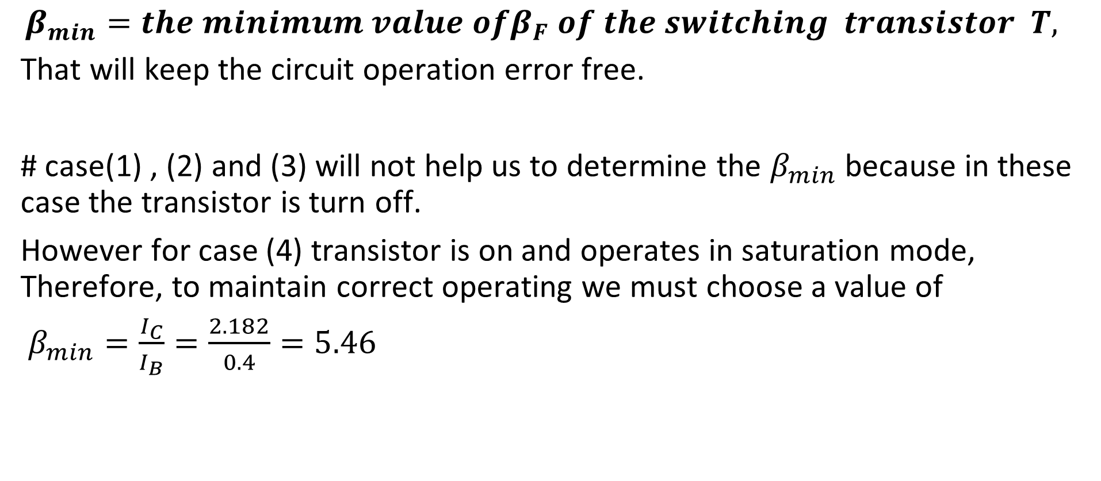
DTL

Slide 3
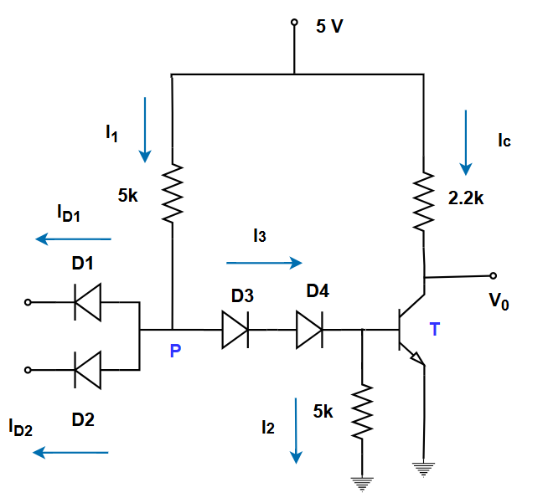
Noise Margin of DTL
NM calculation of DTL is not similar to the RTL circuit.

Slide 4
Noise Margin of DTL
Example: IF all the inputs are high, what is the magnitude of noise voltage which will cause the gate to malfunction ?
# correct operating condition when all inputs are high.
Case (4). D1 , D2 off.
D3 and D4 ON 🡪 Sat
# The circuit will malfunction if it starts operating in case (1) conditions.
D1, D2 on, D3 , D4, T off.
# If D1 and D2 starts conducting, they will have precedence over D3, D4 and T because of lower resistance at that direction.

Slide 5
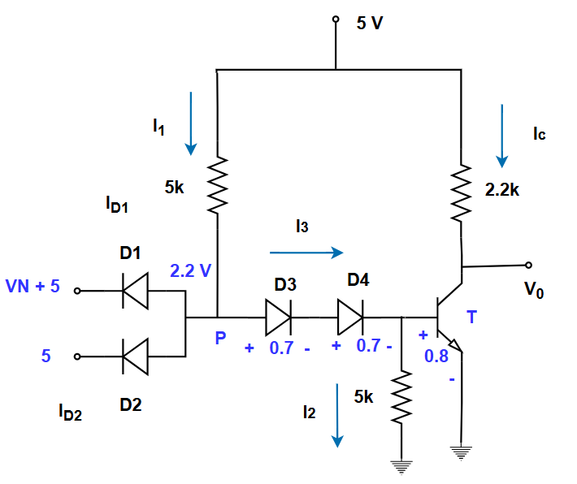
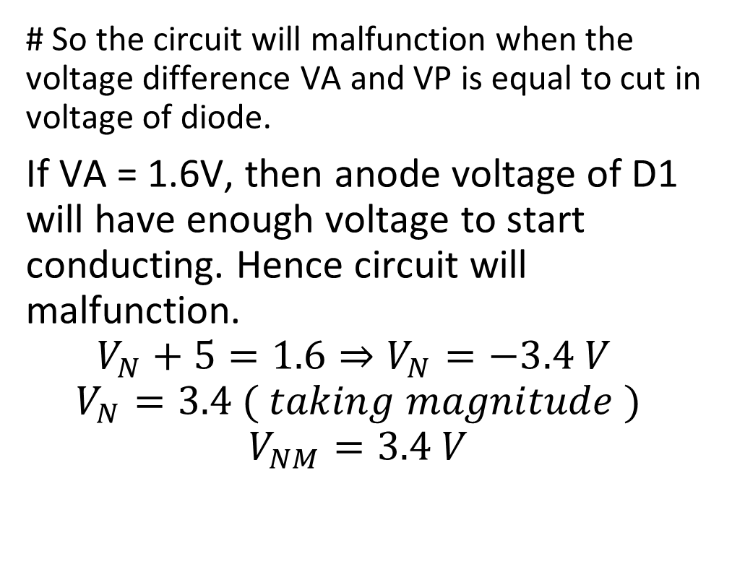
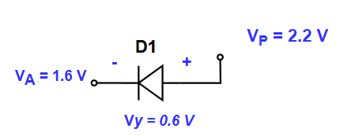
Noise Margin of DTL

Slide 6
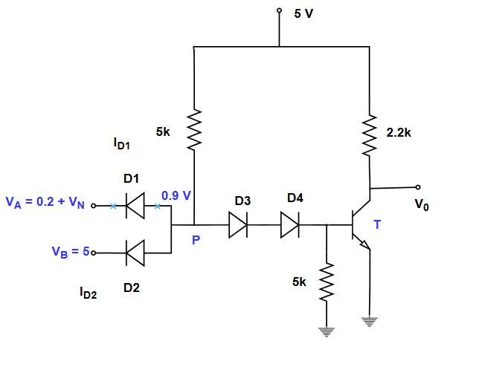
Noise Margin of DTL
Q. If one of the inputs is low and others are high, then what magnitude of noise voltage at low input terminal will cause the transistor to malfunction ?
# valid operation: case (2) D1 on, D2, D3, D4 , T off.
# The circuit will malfunction if D3, D4 and T start conducting or turned on.
# As long as D1 is on any increment in noise voltage at node A will also increase the voltage at Vp. Because, the difference between anode and cathode terminal should be 0.7 V for conducting diode D1.

Slide 7
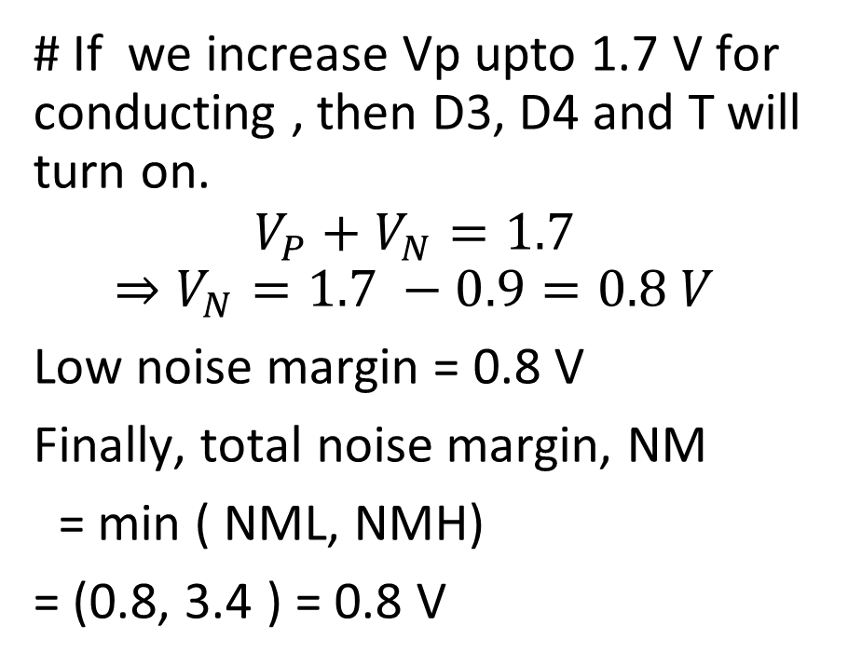
DTL NAND Gate

Slide 8
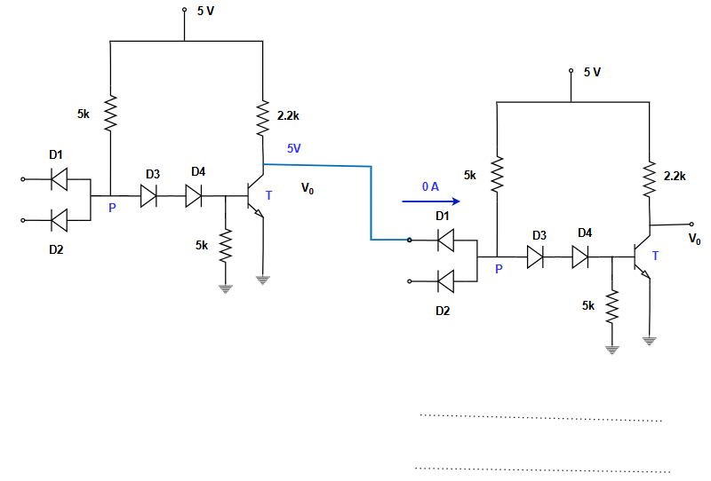
Fanout Calculation
Different from RTL

Slide 9
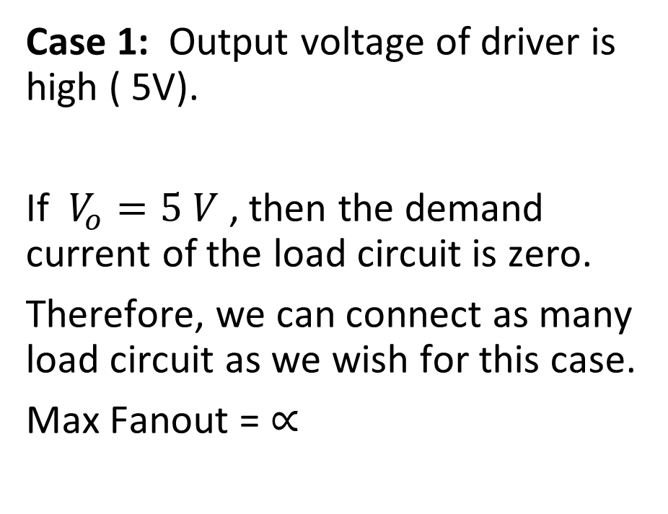
Fanout Calculation

Slide 10
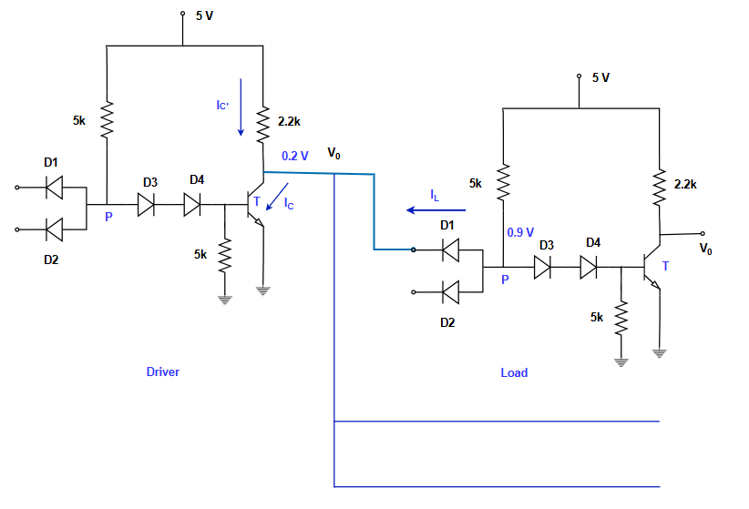
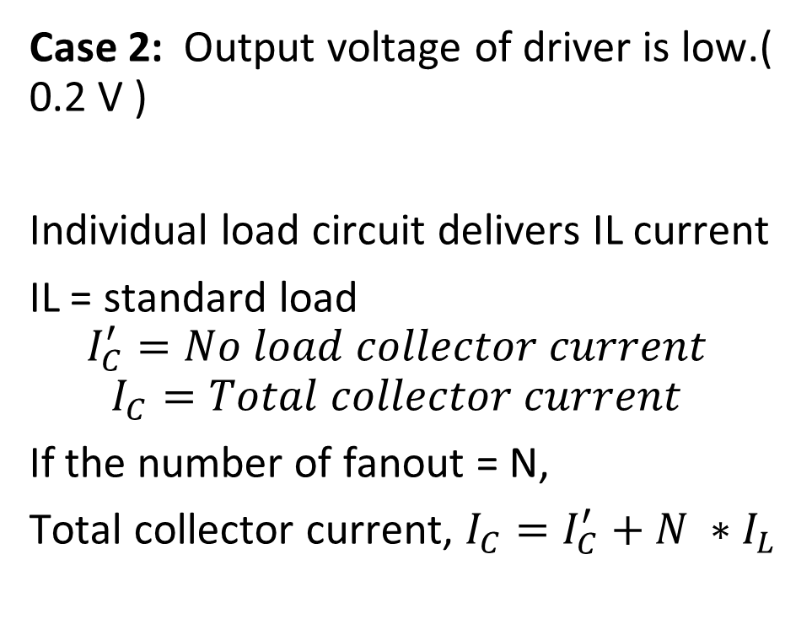
Fanout Calculation

Slide 11
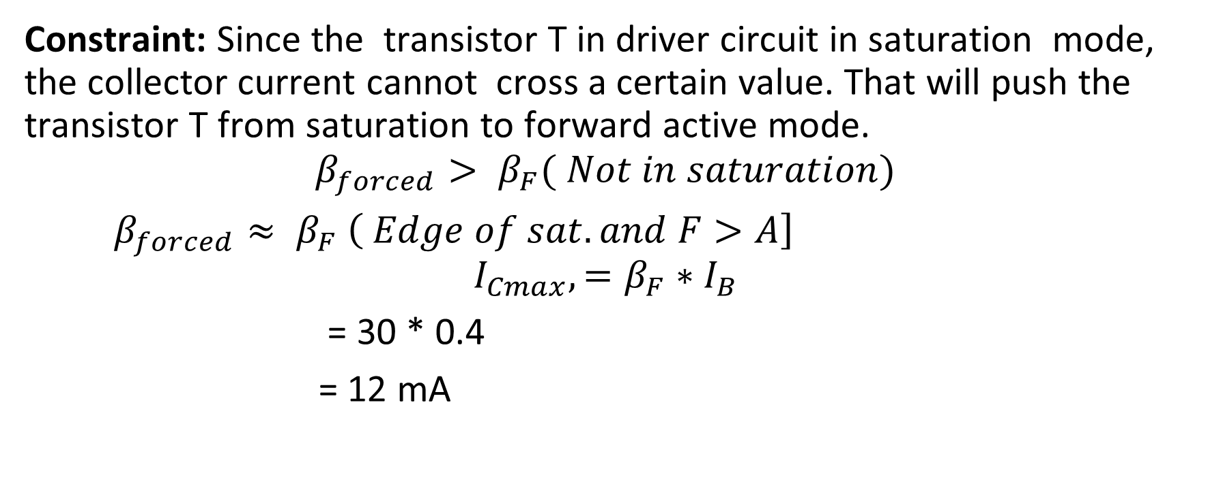
Fanout Calculation

Slide 12
Fanout Calculation

Slide 13
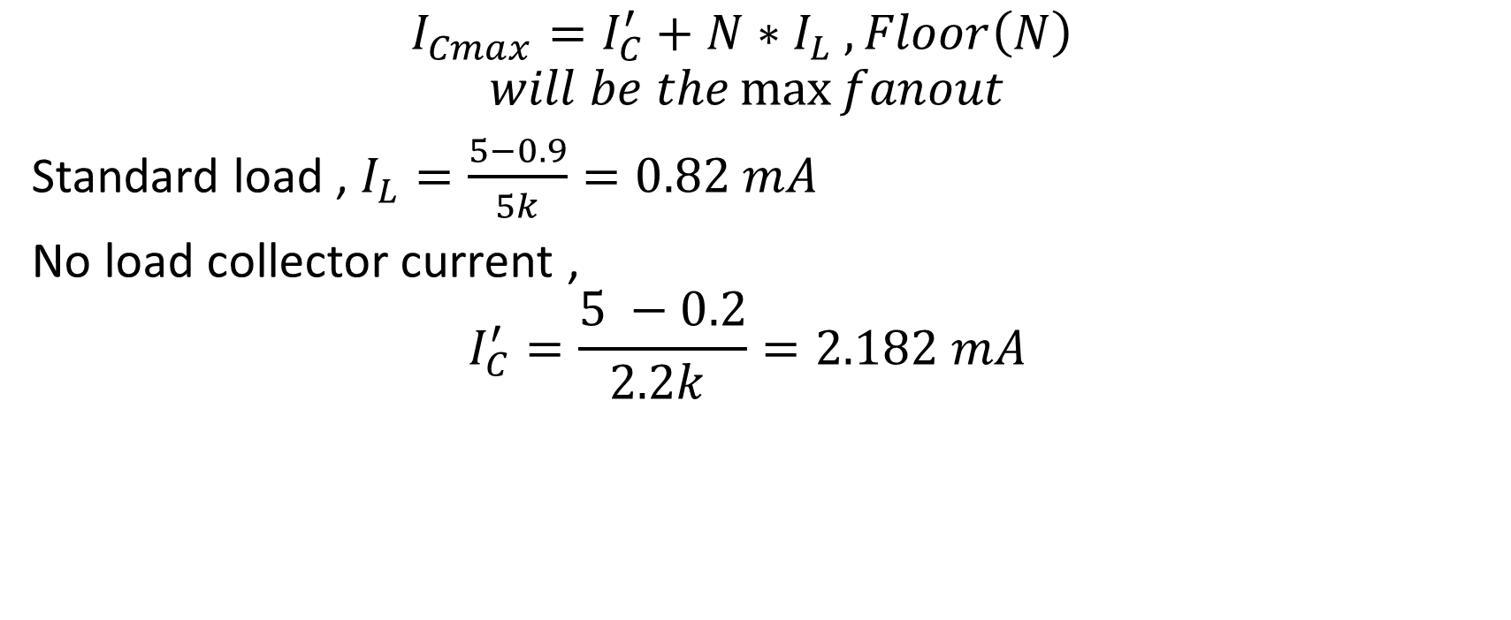
Fanout Calculation

Slide 14
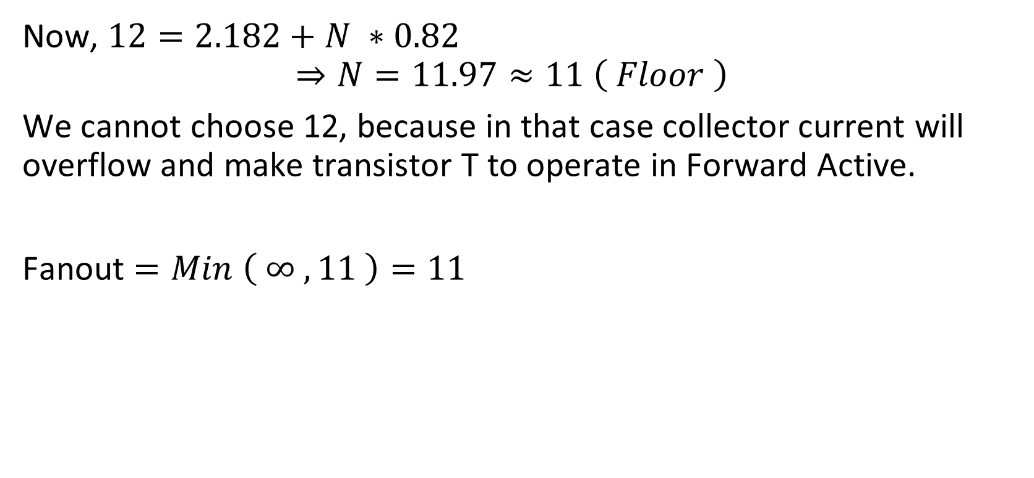
Fanout Calculation

Slide 15
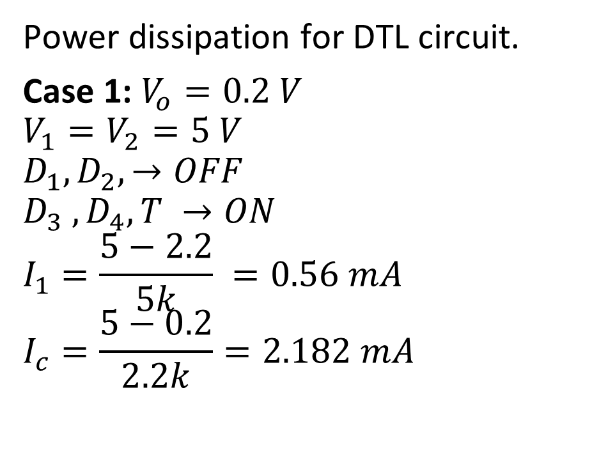
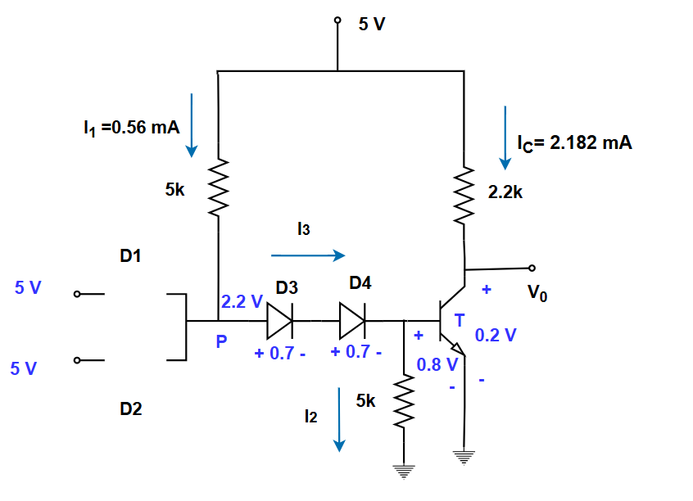
DTL Power Dissipation

Slide 16
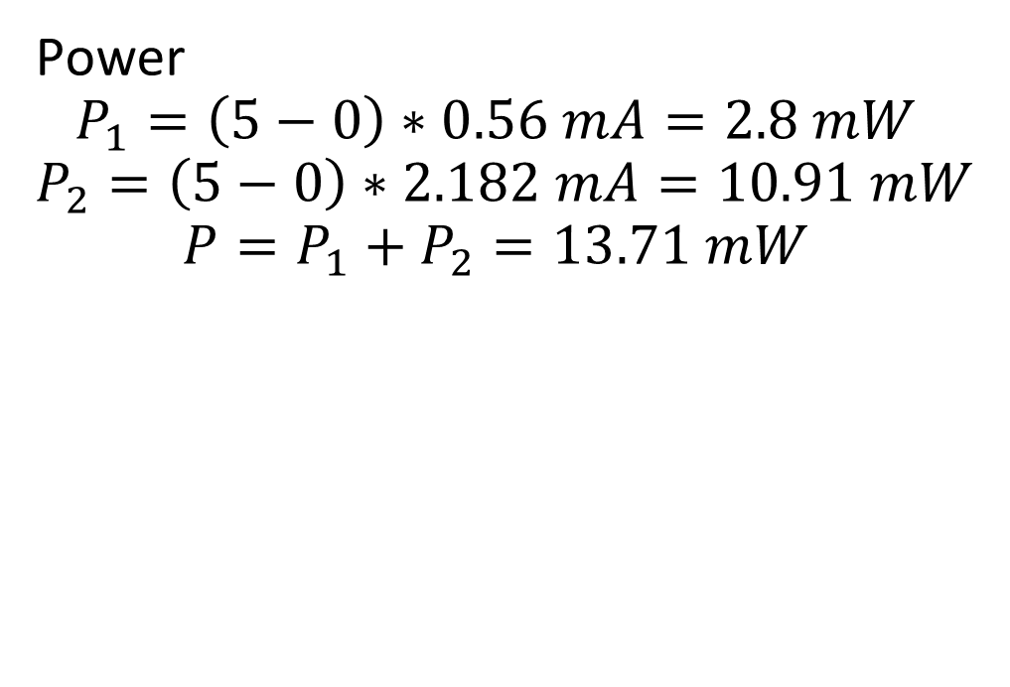
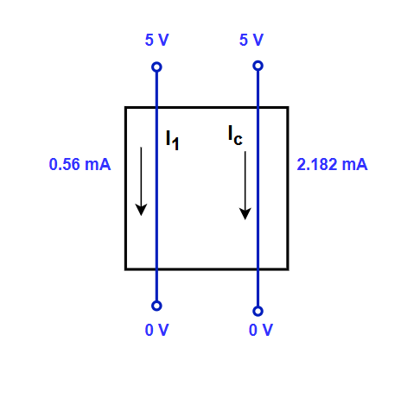
DTL Power Dissipation

Slide 17
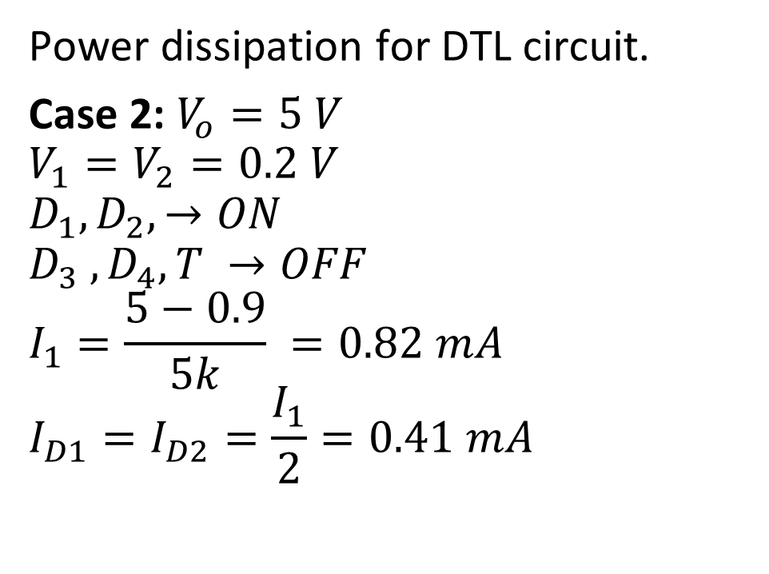
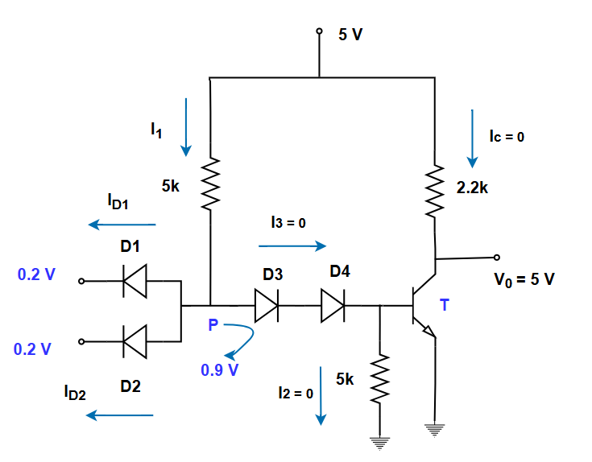
DTL Power Dissipation

Slide 18
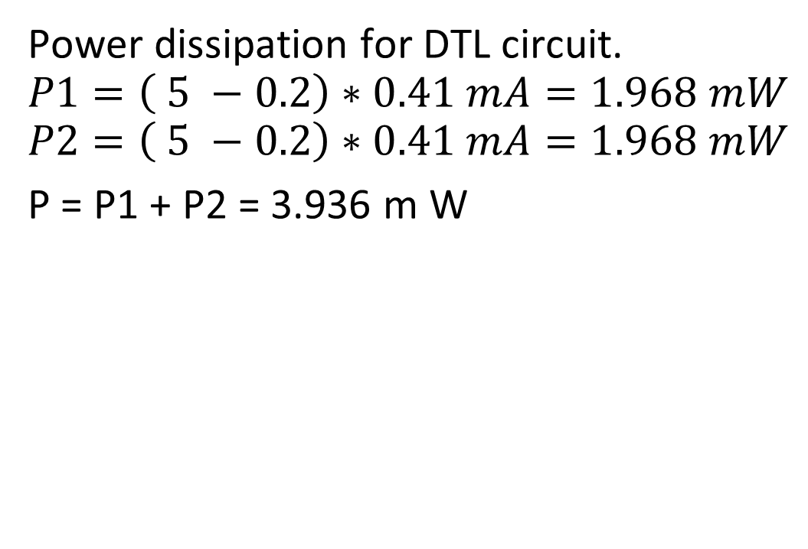
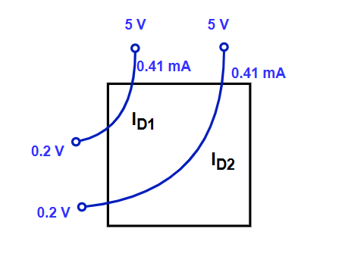
DTL Power Dissipation

Slide 19
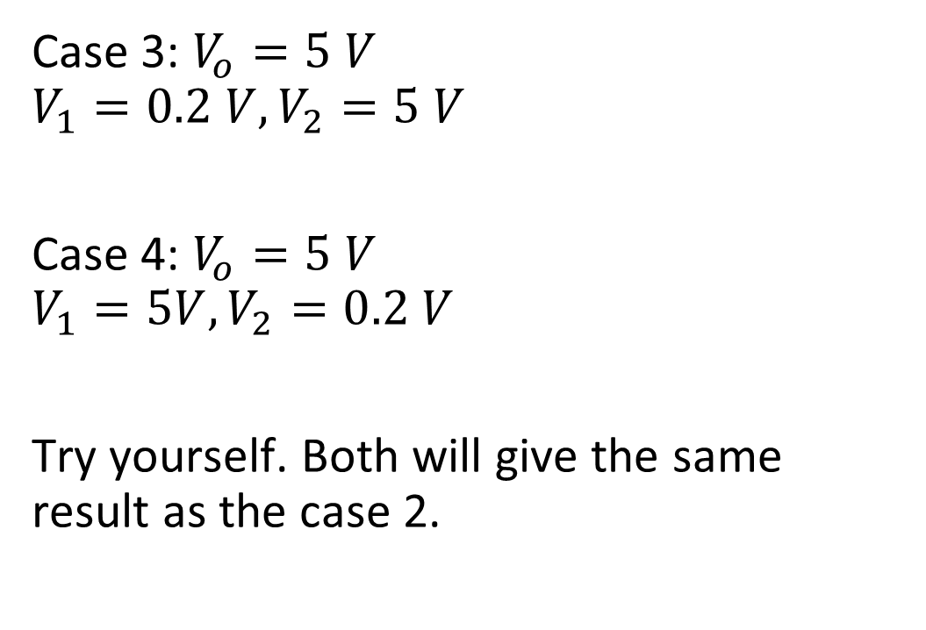
DTL Power Dissipation

